Slide 1


Multi Objective Optimization of Redundancy, Maintenance and Spare Parts Under Uncertainty
Student: Ahsanul Abedin ID: A05376945
Instructor: Dr. Clara Novoa

Slide 2
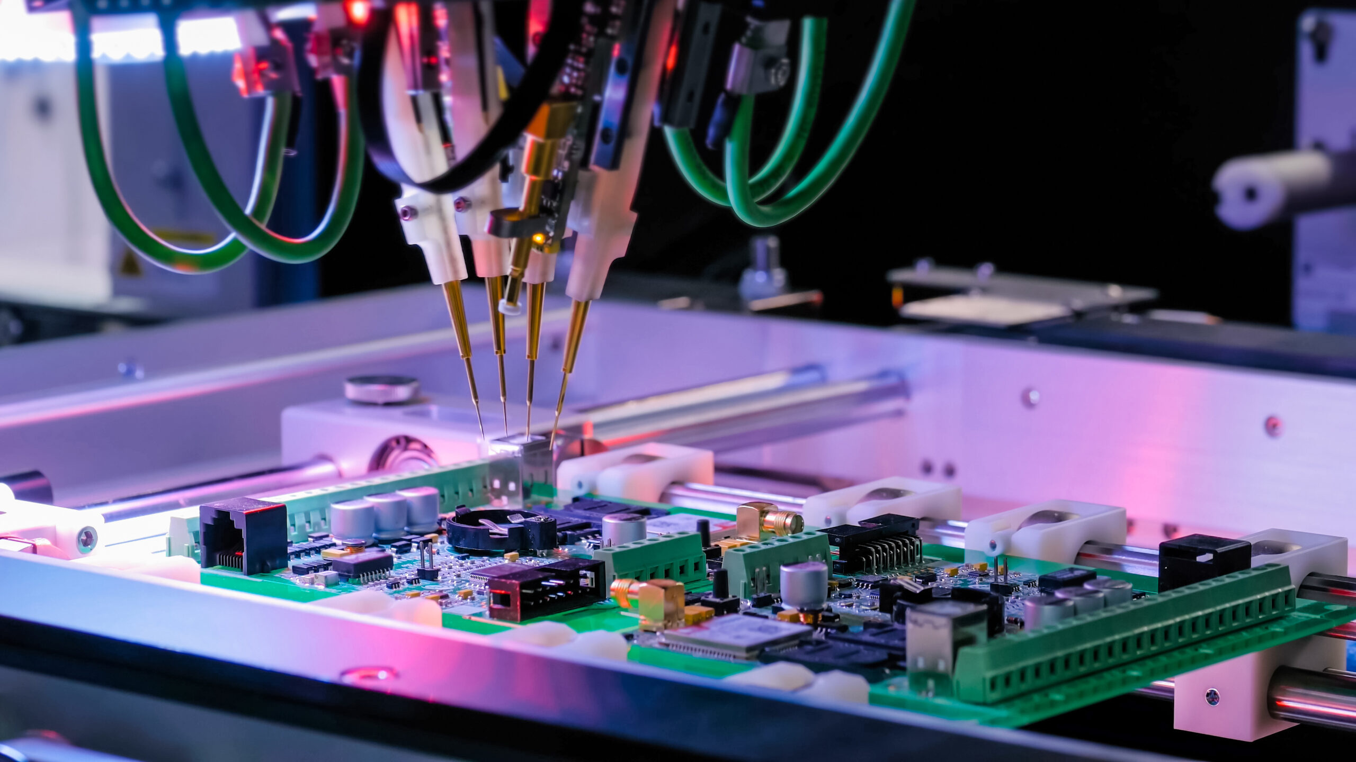
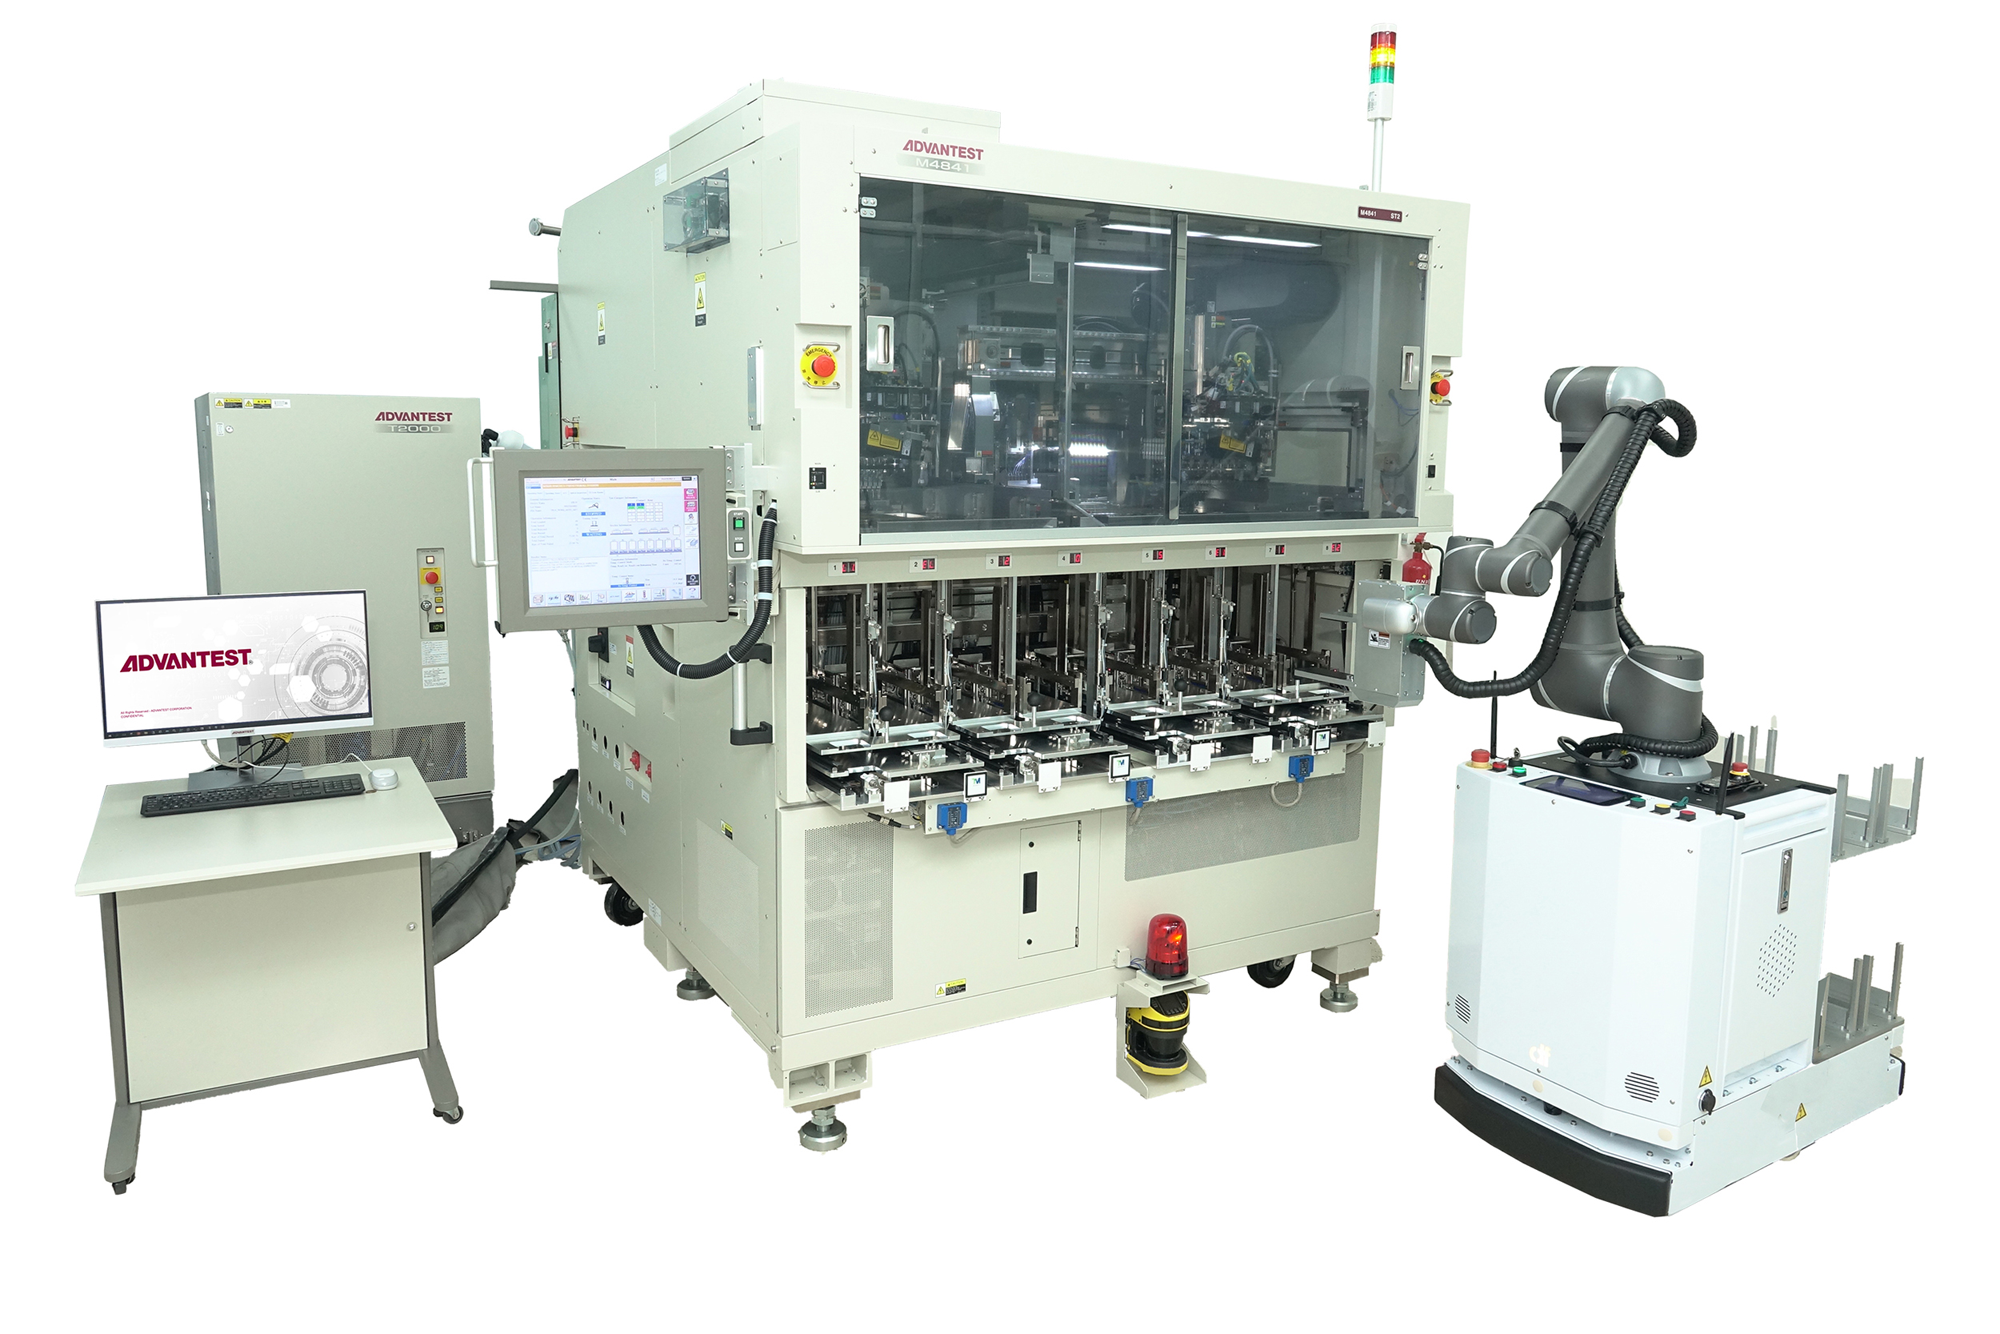
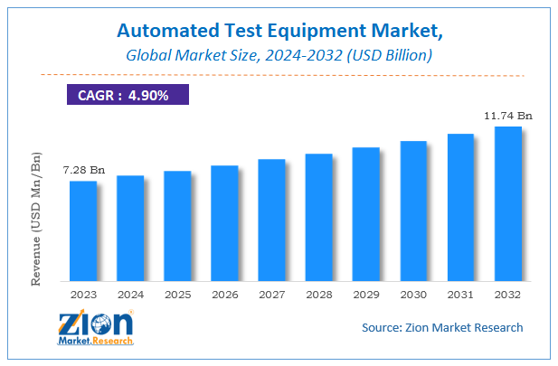
Automated Test Equipment

Slide 3
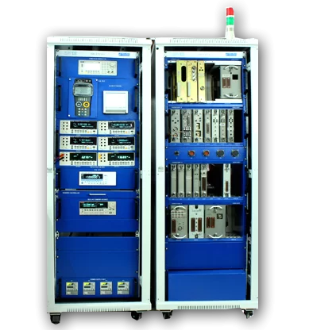
Part1
Part2
Part(N)
K-out-of N Active Redundant System

Slide 4
Failure Returns of Corrective Replacement
Repairing failed parts M/M/q/infinity
Customer Site
m Systems at customer site.
Each System has N redundant subsystem
Age-based Replacement
Redundancy Allocation in System Design and Manufacturing
Spare Parts Inventory with y_{i}
_{For i =1, 2, ….., N}
Renewing degraded parts M/M/r/infinity
Pro-active Replacement Returns
Installing New Systems in the Site
Product-Service Integration with Decentralized Repair Services

Slide 6
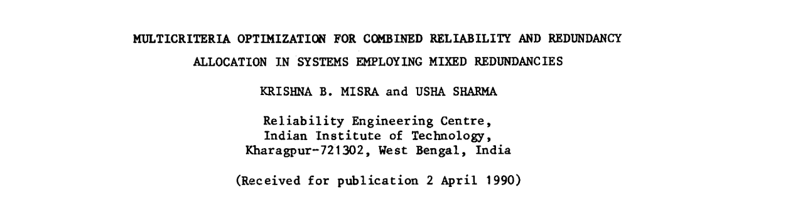
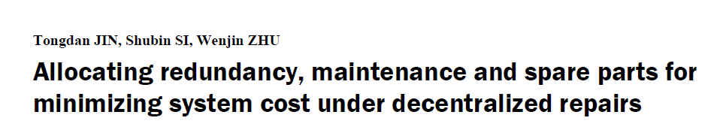
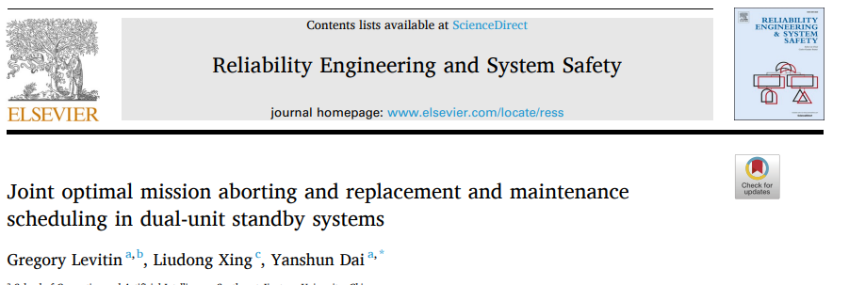
Literature Review:

Slide 7

Assumptions
Failure occurs randomly using Weibull Distribution
Renewal and Repair shops use M/M/r/infinity and M/M/q/infinity
There are one part type
Number of system N=1 and fleet Size m=50
Parts are replaceable (Line Replacement Units)

Slide 8
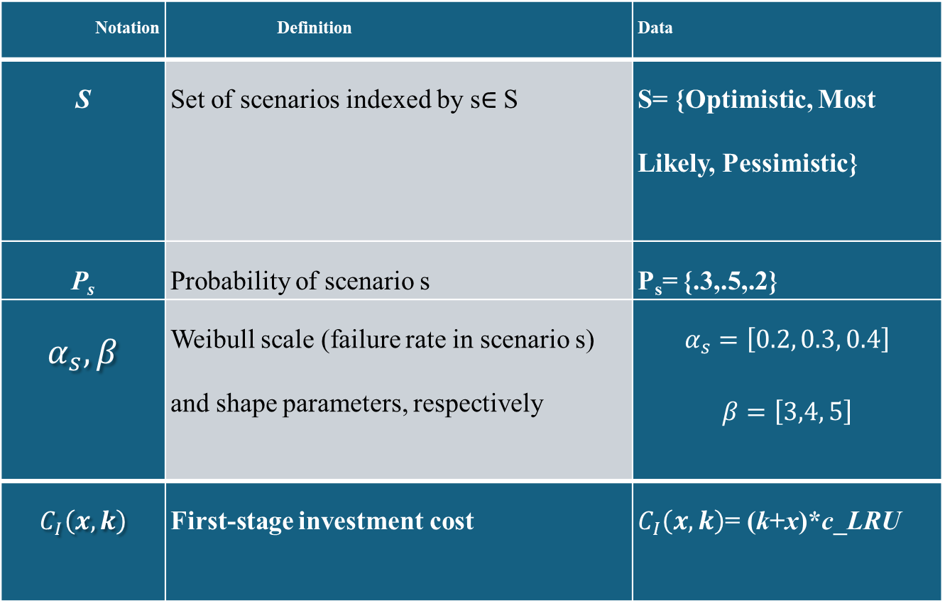
Notation | Definition | Data
S | Set of scenarios indexed by s∈ S | S= {Optimistic, Most Likely, Pessimistic}
P_{s} | Probability of scenario s | P_{s}= {.3,.5,.2}
$$α_{s},β$$ | Weibull scale (failure rate in scenario s) and shape parameters, respectively | $$α_{s}=\left[0.2, 0.3, 0.4\right]$$ $$β=\left[3,4, 5\right]$$
$$C_{I}\left(x,k\right)$$ | First-stage investment cost | $C_{I}\left(x,k\right)$= (k+x)*c_LRU
Input Parameters

Slide 9
Notation | Definition
x | component redundancy level
y | base-stock level for spares inventory
τ | replacement age or interval for
r | number of renewing servers
q | number of repair servers
Decision Variables

Slide 10
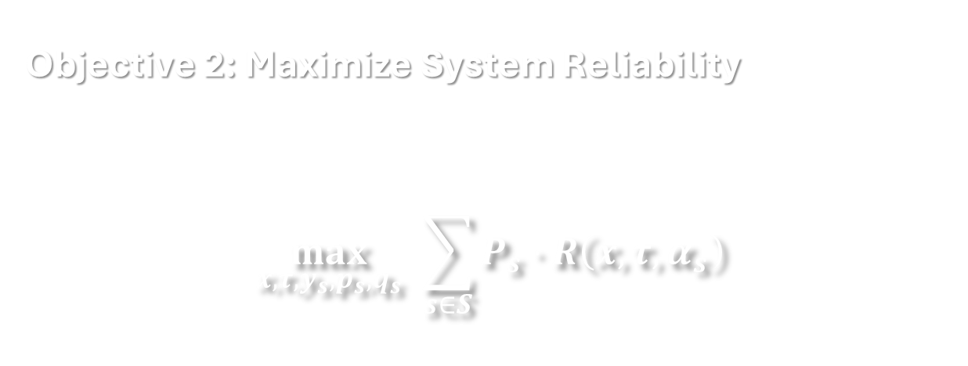
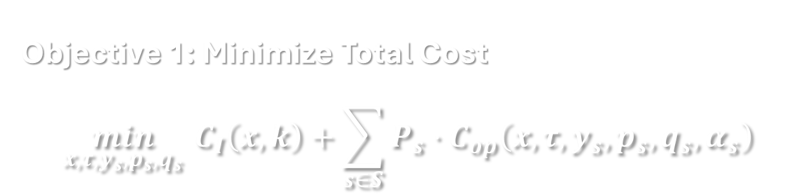
Objective Functions
Objective 1: Minimize Total Cost
$$\begin{aligned}\min_{x,τ,y_{s},p_{s},q_{s}} C_{I}\left(x,k\right)+\sum_{s∈S}^{​}{P_{s}}⋅C_{op}\left(x,τ,y_{s},p_{s},q_{s},α_{s}\right)\#\end{aligned}$$
Objective 2: Maximize System Reliability
$$\begin{aligned}\max_{x,τ,y_{s},p_{s},q_{s}} \sum_{s∈S}^{​}{P_{s}}⋅R\left(x,τ,α_{s}\right)\#\end{aligned}$$

Slide 11

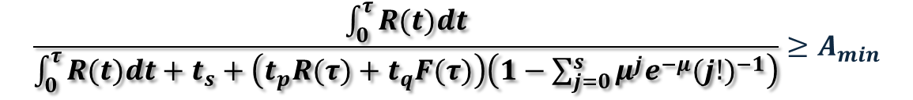
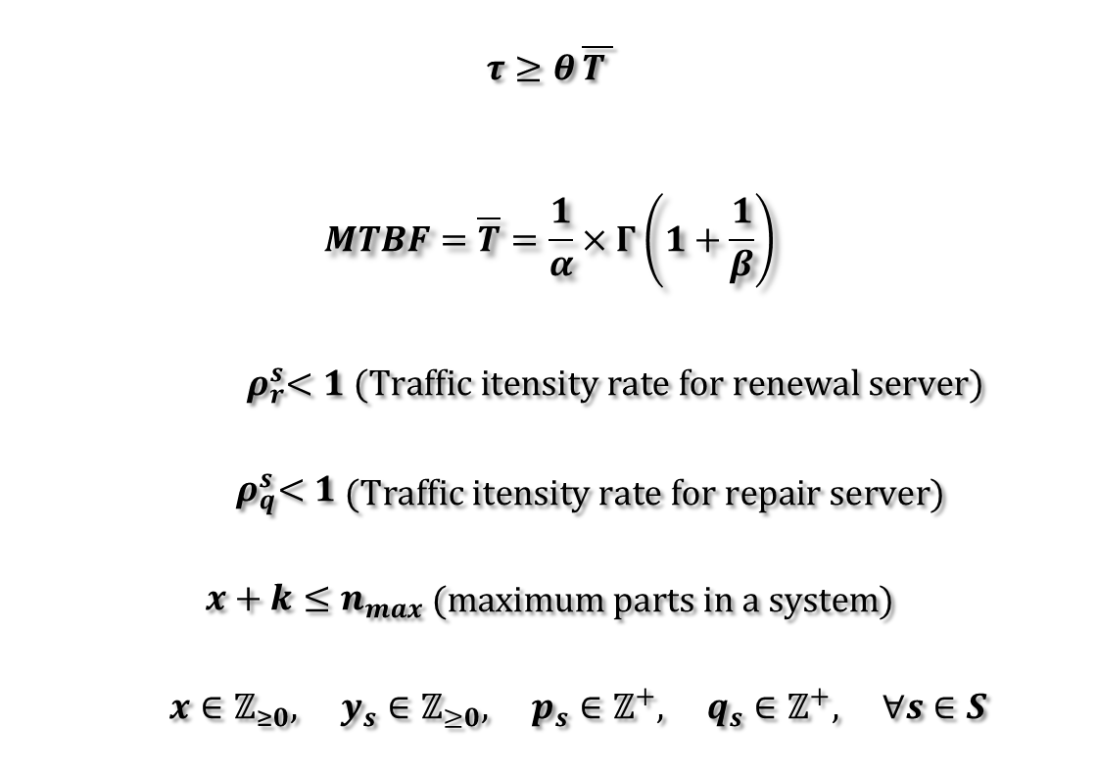
$$\frac{\int_{0}^{τ}{R(t)dt}}{\int_{0}^{τ}{R(t)dt}+t_{s}+\left(t_{p}R(τ)+t_{q}F(τ)\right)\left(1−\sum_{j=0}^{s}{μ^{j}e^{−μ}(j!)^{−1}}\right)}≥A_{min}$$
$$A(availability)=\frac{MTBR}{MTBR+MDT}$$
$$\begin{aligned}τ≥θ \overline{T }\#\end{aligned}$$
$$\begin{aligned}MTBF=\overline{T}=\frac{1}{α}×Γ\left(1+\frac{1}{β}\right)\#\end{aligned}$$
$$\begin{aligned}{ ρ}_{r}^{s}<1 (Traffic itensity rate for renewal server)\#\end{aligned}$$
$$\begin{aligned}{ ρ}_{q}^{s}<1\#\end{aligned} (Traffic itensity rate for repair server)$$
$$\begin{aligned}x+k≤n_{max}\#\end{aligned} (maximum parts in a system)$$
$$\begin{aligned} x∈ℤ_{≥0}, y_{s}∈ℤ_{≥0}, p_{s}∈ℤ^{+}, q_{s}∈ℤ^{+}, ∀s∈S\#\end{aligned}$$
Constraints

Slide 12
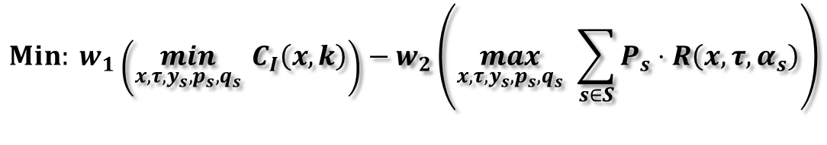

Solutions
Phase1: (Design)
$$Min: w_{1}\left(\min_{x,τ,y_{s},p_{s},q_{s}} C_{I}\left(x,k\right)\right)−w_{2}\left(\max_{x,τ,y_{s},p_{s},q_{s}} \sum_{s∈S}^{​}{P_{s}}⋅R\left(x,τ,α_{s}\right)\right)$$
S.t:
Variable types: 444 continuous, 21 integer (20 binary)
$$τ≥θ \overline{T }$$
Using Gurobi:
$$\begin{aligned}x+k≤n_{max}\#\end{aligned} (maximum parts in a system)$$
✅ Optimal Solution:
x = 9
Tau = 3.1255
Investment Cost 123025.00
Reliability (optimistic) 0.999999
Reliability (most_likely) 0.997013
Reliability (pessimistic) 0.292780
Expected Reliability 0.927187
$$x∈ℤ_{≥0},$$
w₁ =1 w₂ =10⁶

Slide 13

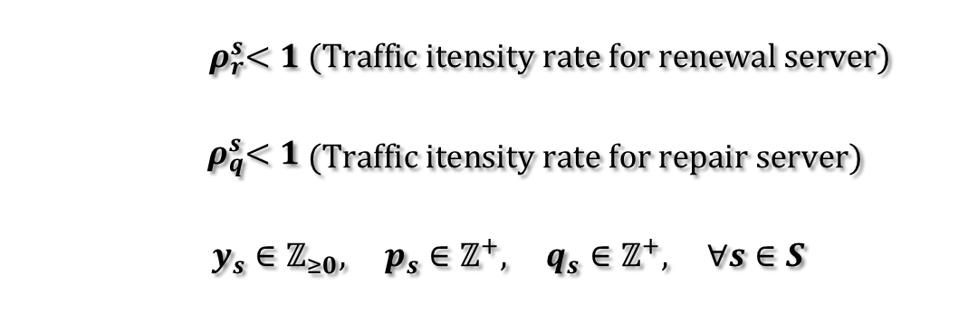
Solutions
Phase2: (Operational)
$$\min_{x,k,y_{s},p_{s},q_{s}} \sum_{s∈S}^{​}{P_{s}}⋅C_{op}\left(x,k,y_{s},p_{s},q_{s},α_{s}\right)$$
Using Gurobi Variable types: 25222 continuous, 129 integer (123 binary)
S.t:
 | Optimistic | Most-Likely | Pessimistic
r | 2 | 2 | 3
q | 2 | 2 | 4
y | 16 | 19 | 22
$$τ≥θ \overline{T }$$
$$\begin{aligned}{ ρ}_{r}^{s}<1 (Traffic itensity rate for renewal server)\#\end{aligned}$$
$$\begin{aligned}{ ρ}_{q}^{s}<1\#\end{aligned} (Traffic itensity rate for repair server)$$
$$\begin{aligned} y_{s}∈ℤ_{≥0}, p_{s}∈ℤ^{+}, q_{s}∈ℤ^{+}, ∀s∈S\#\end{aligned}$$
Operational Cost: 137290 $

Slide 14
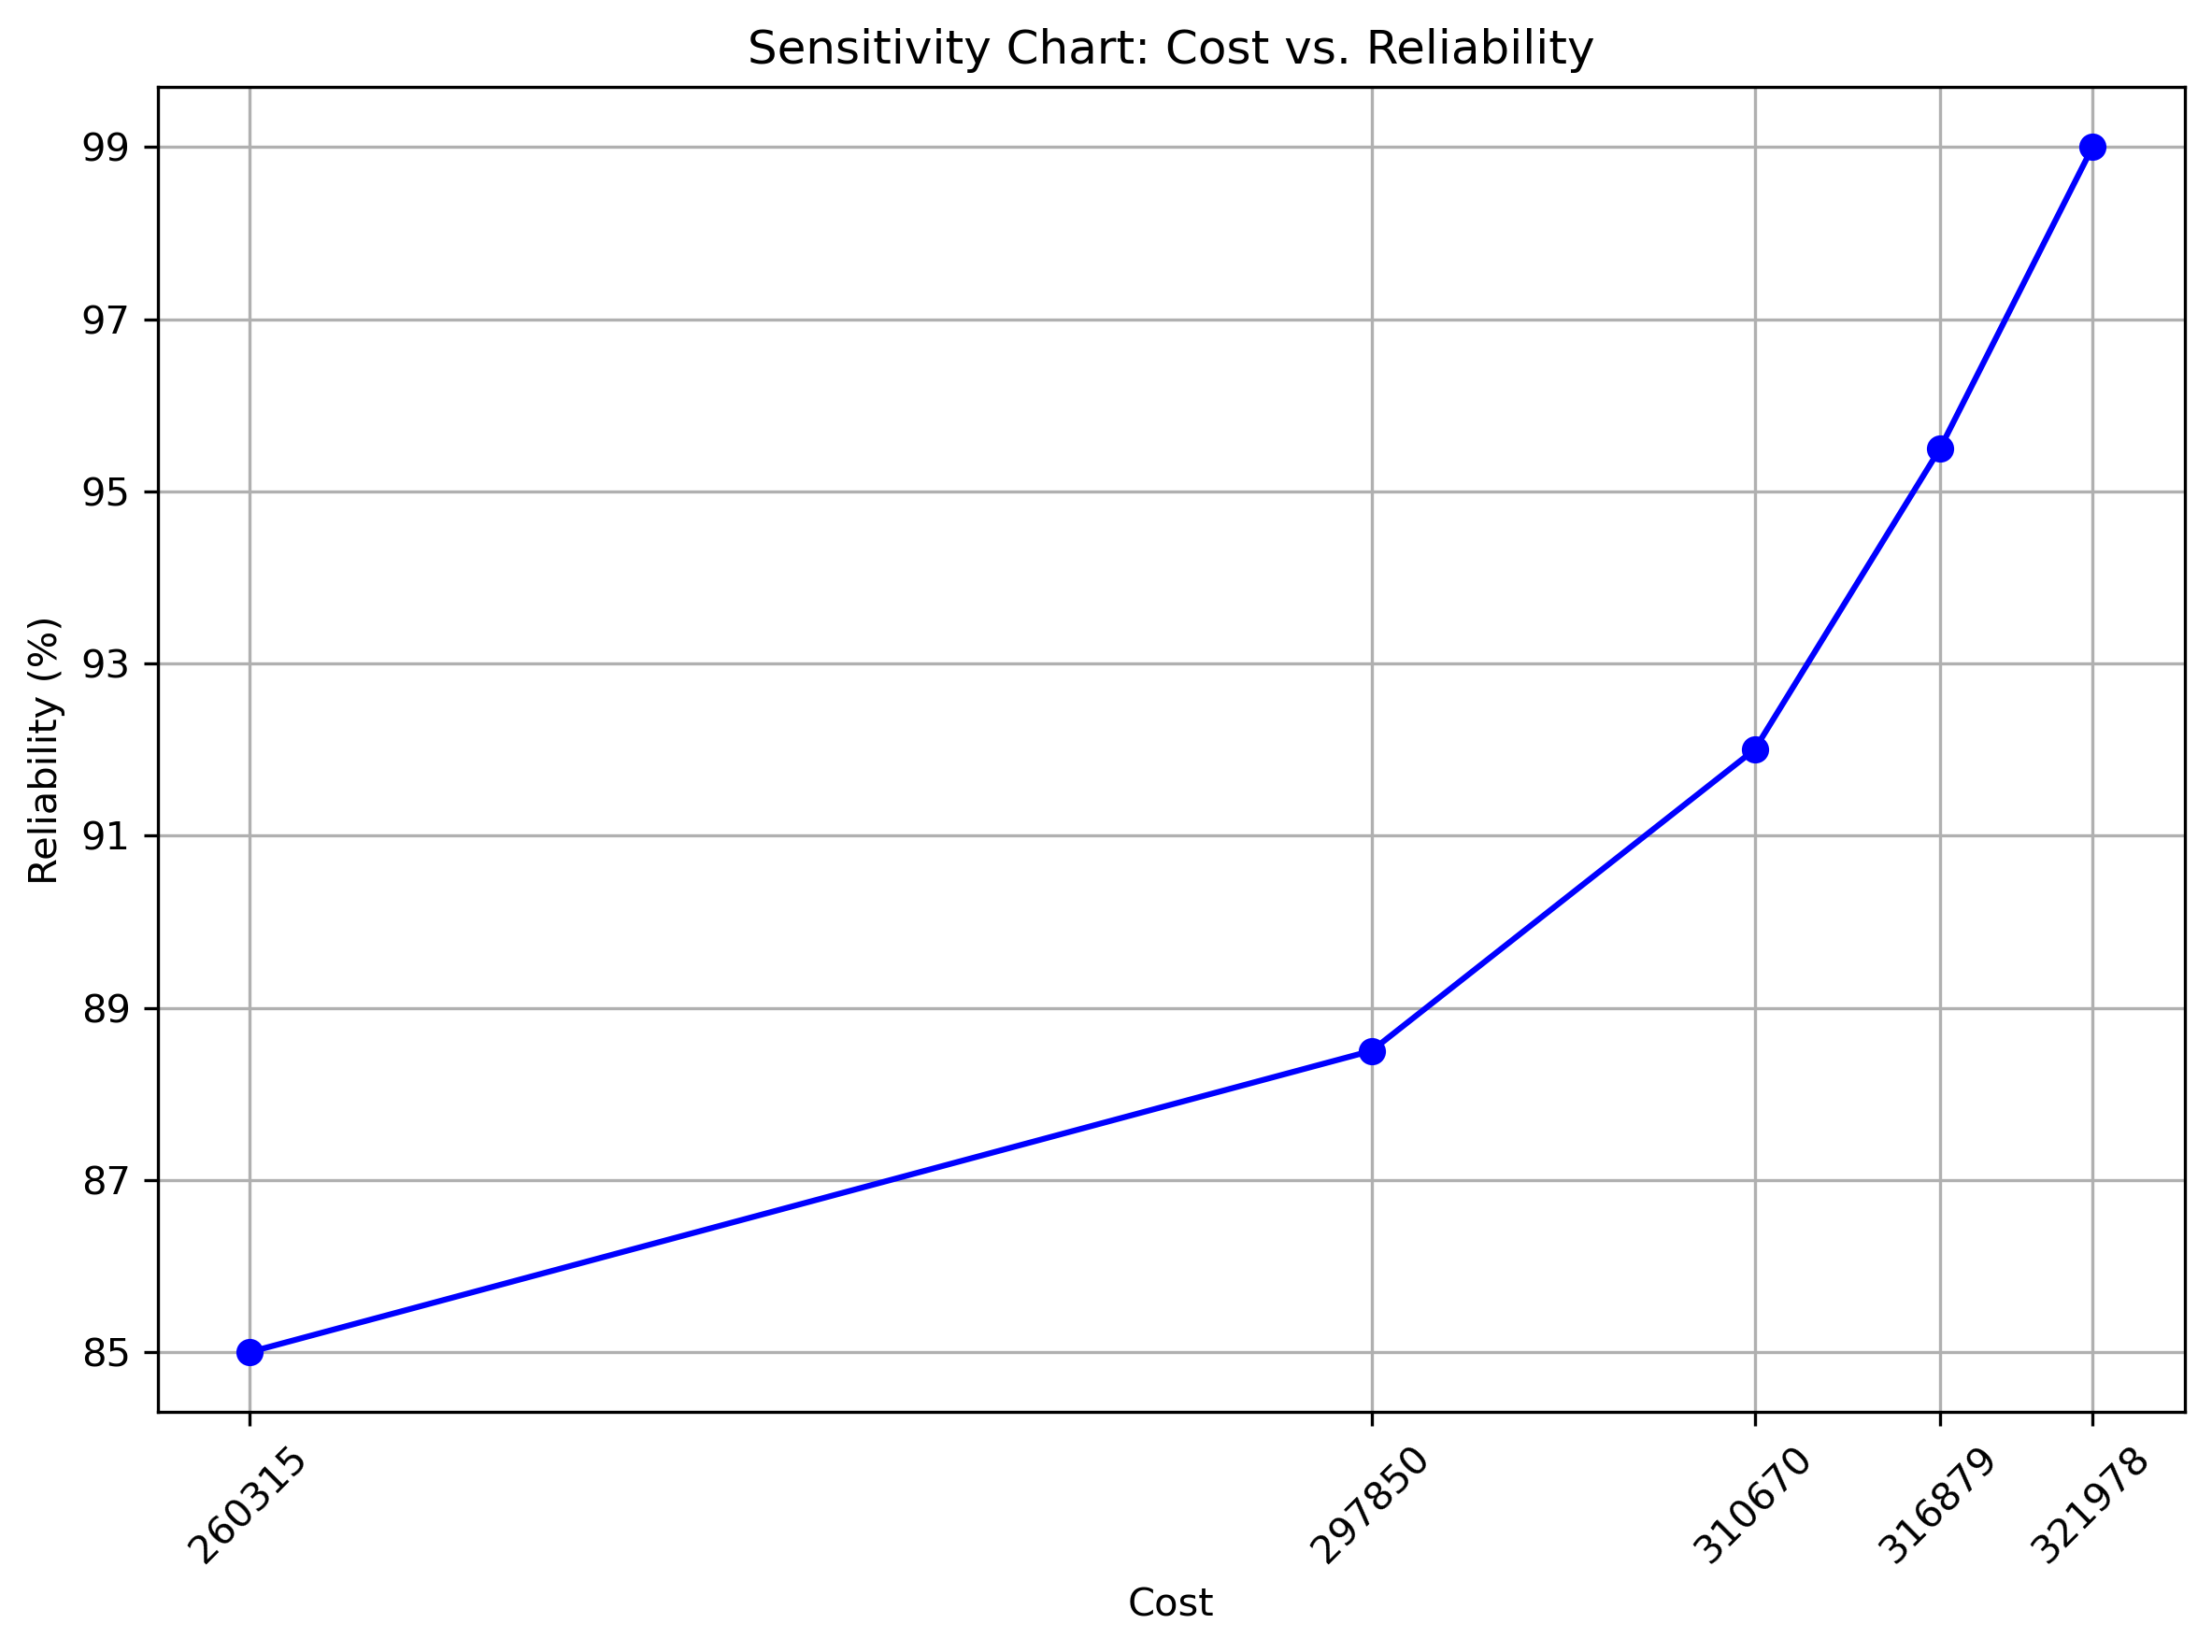
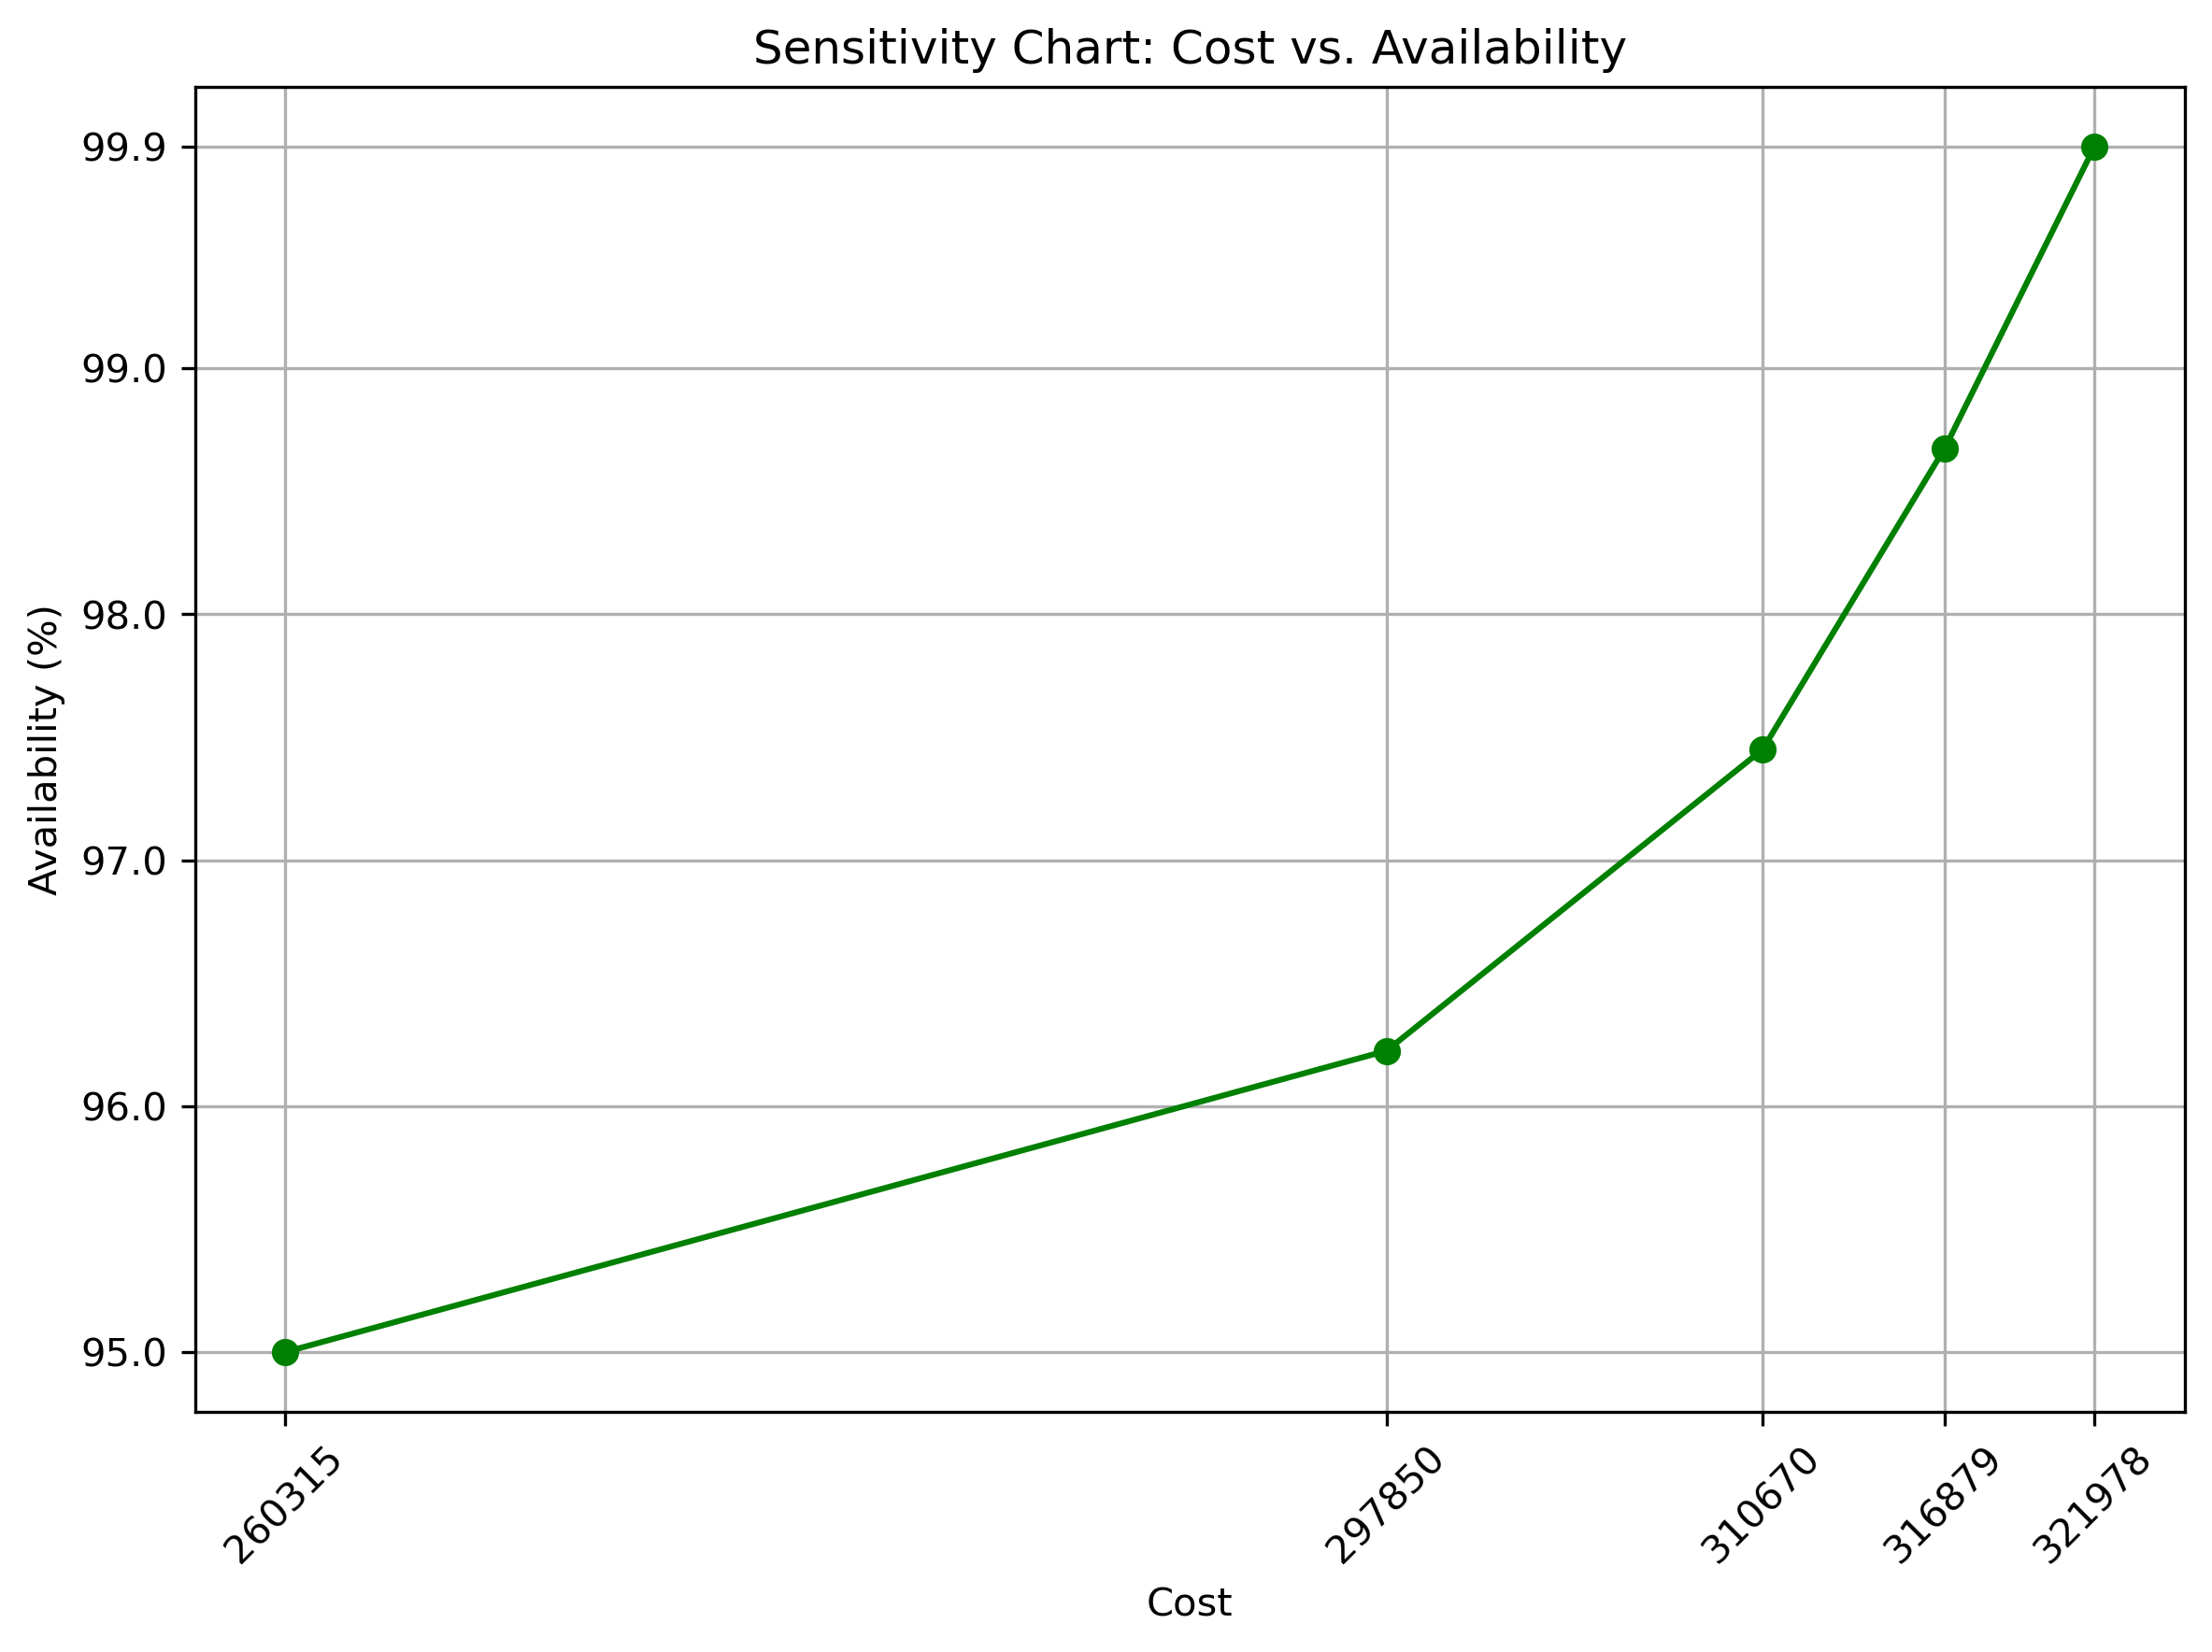
Sensitivity

Slide 15
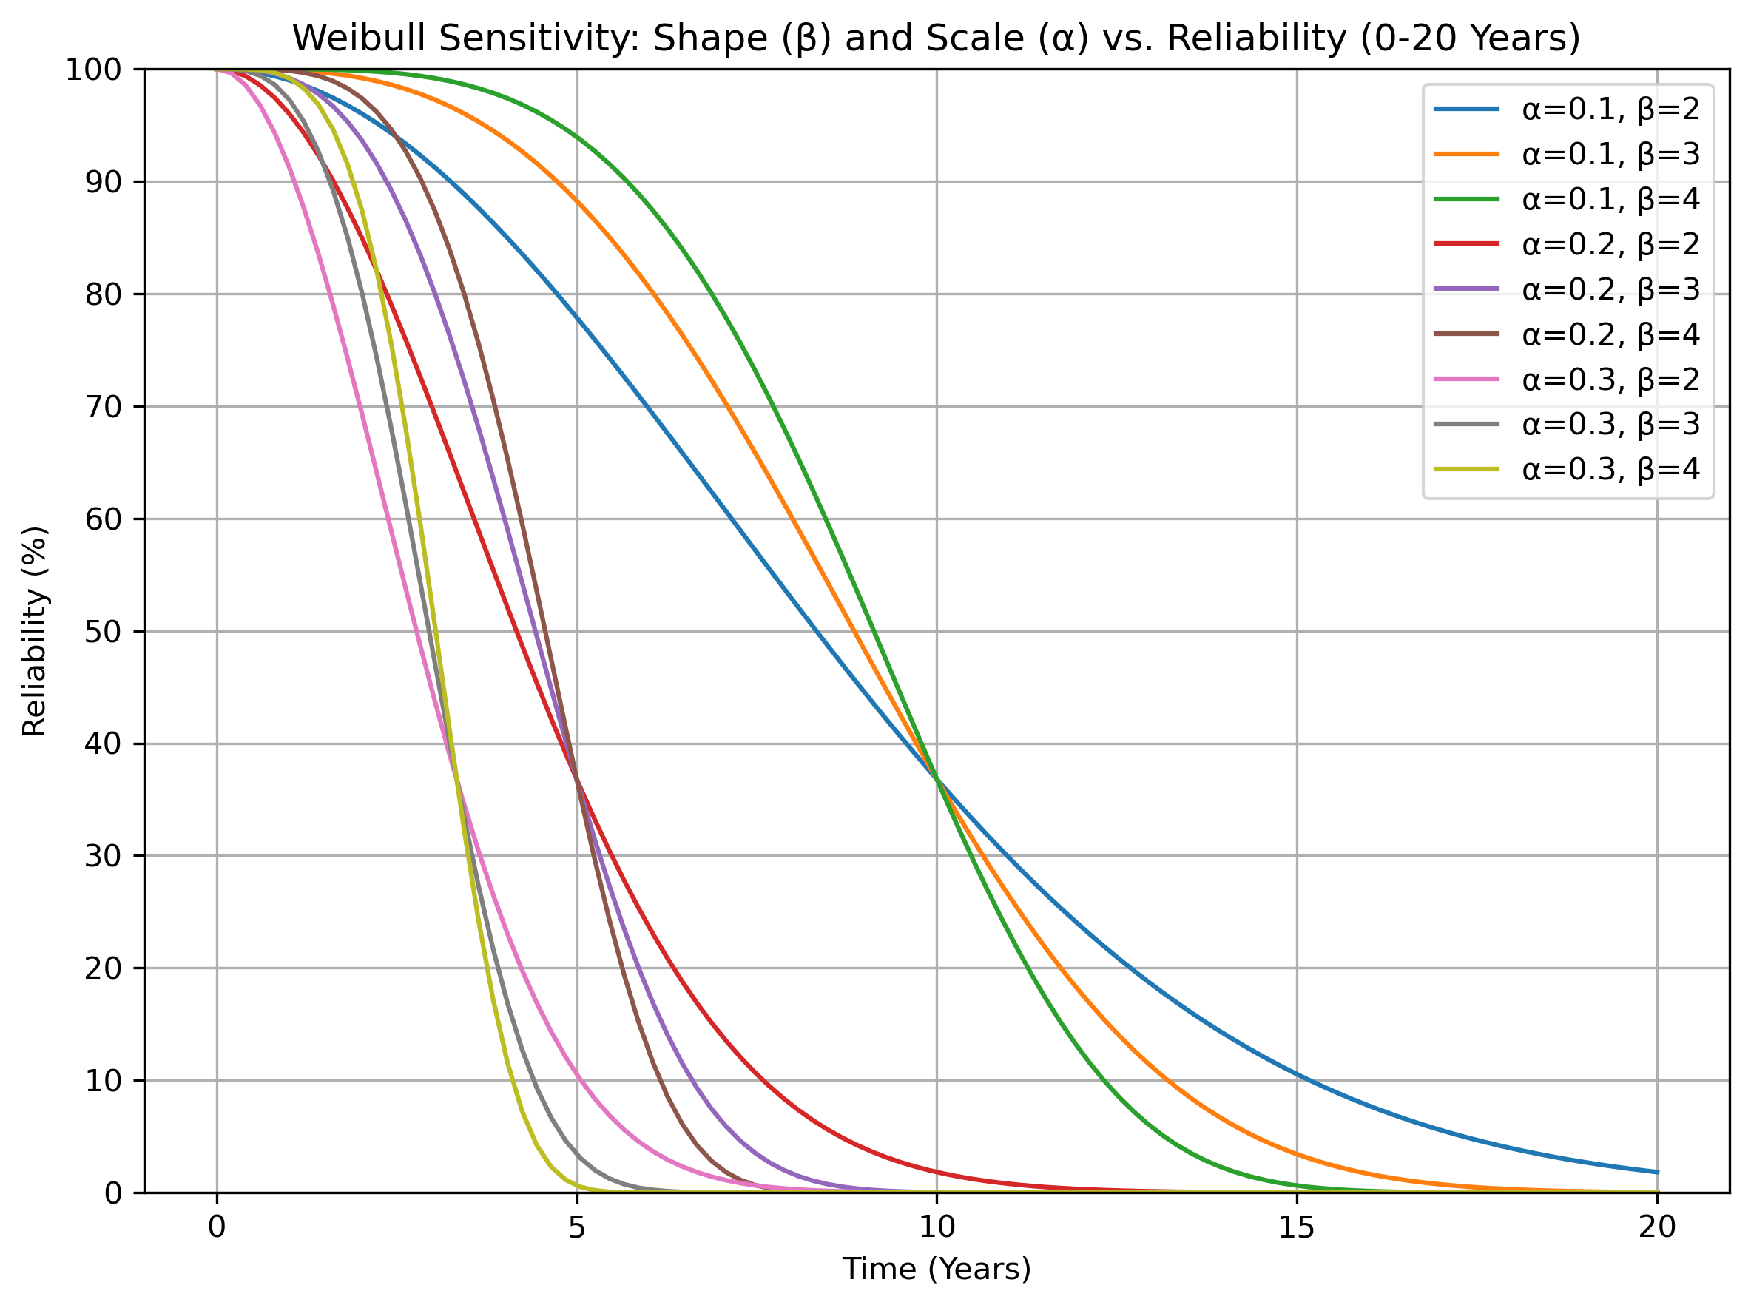

Slide 16


